Slide 1
HW9-6 第五組

Slide 2
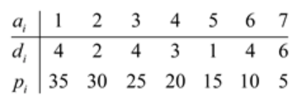
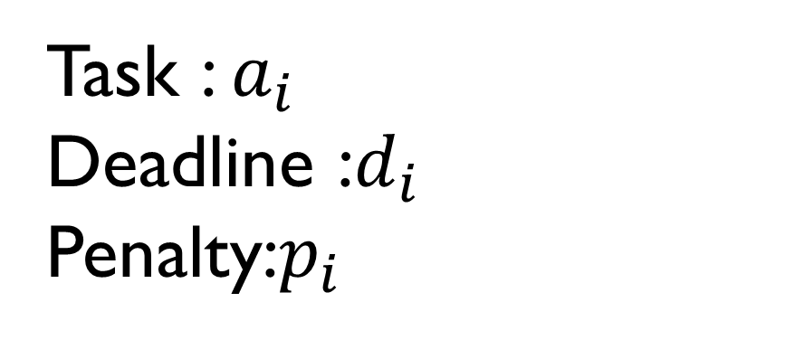
Argue that this algorithm always gives an optimal answer
Consider the following table:
Task : $a_{i^{ }}$
Deadline :$d_{i^{ }}$
Penalty:$p_{i^{ }}$

Slide 3
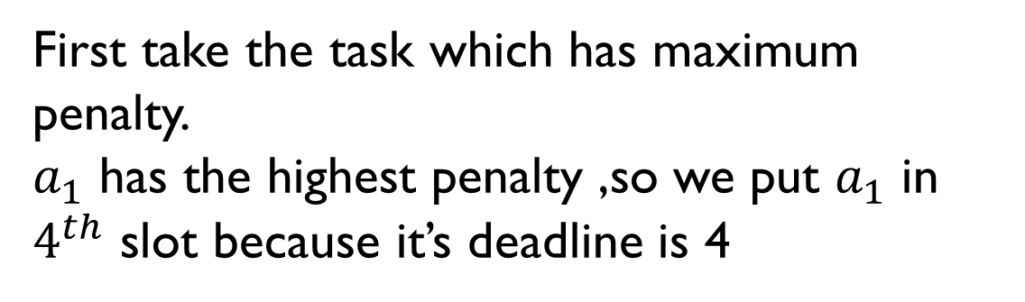
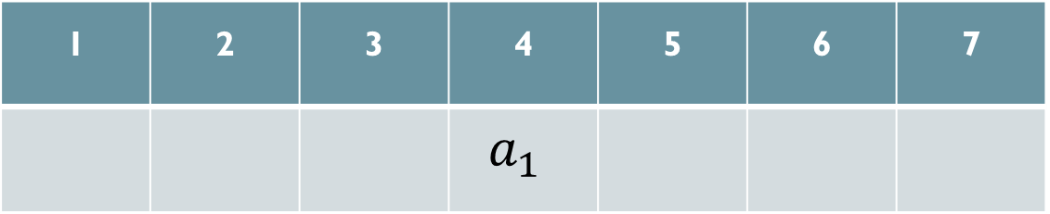
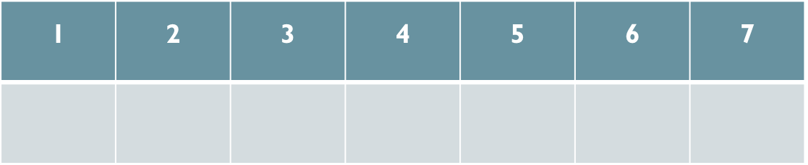
Argue that this algorithm always gives an optimal answer
First take the task which has maximum penalty.
$a_{1}$ has the highest penalty ,so we put $a_{1}$ in $4^{th}$ slot because it’s deadline is 4
1 | 2 | 3 | 4 | 5 | 6 | 7
1 | 2 | 3 | 4 | 5 | 6 | 7
 |  |  | $$a_{1^{ }}$$

Slide 4
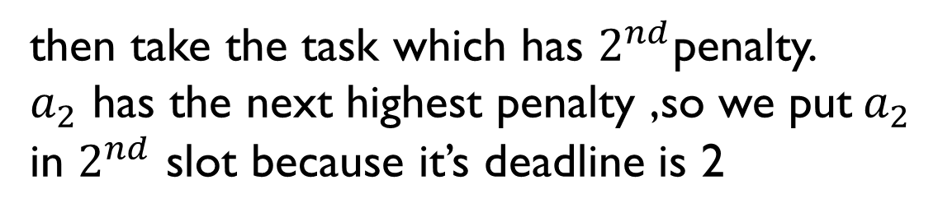
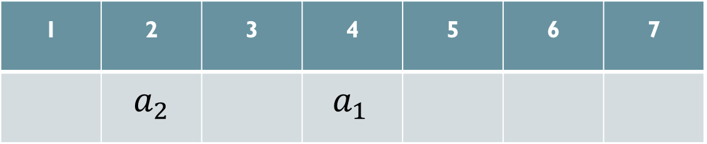
Argue that this algorithm always gives an optimal answer
then take the task which has $2^{nd}$penalty.
$a_{2}$ has the next highest penalty ,so we put${ a}_{2}$ in $2^{nd}$ slot because it’s deadline is 2
1 | 2 | 3 | 4 | 5 | 6 | 7
 |  |  | $$a_{1^{ }}$$
1 | 2 | 3 | 4 | 5 | 6 | 7
 | $$a_{2}$$ |  | $$a_{1^{ }}$$

Slide 5
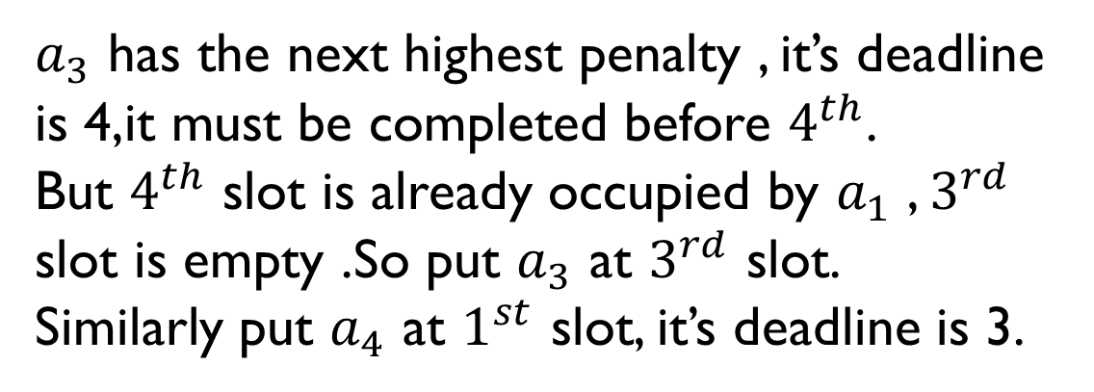
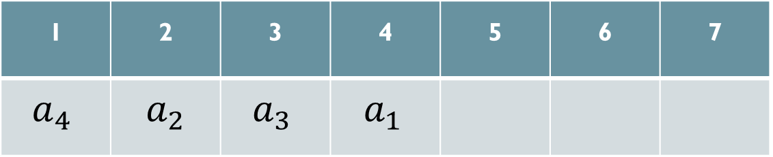

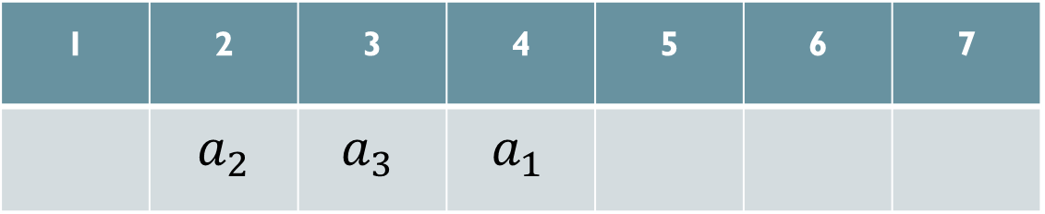
Argue that this algorithm always gives an optimal answer
$a_{3}$ has the next highest penalty , it’s deadline is 4,it must be completed before $4^{th}$.
But $4^{th}$ slot is already occupied by $a_{1}$ , $3^{rd}$ slot is empty .So put $a_{3}$ at $3^{rd}$ slot.
Similarly put $a_{4}$ at $1^{st}$ slot, it’s deadline is 3.
1 | 2 | 3 | 4 | 5 | 6 | 7
 | $$a_{2}$$ | $$a_{3^{ }}$$ | $$a_{1^{ }}$$
1 | 2 | 3 | 4 | 5 | 6 | 7
 | $$a_{2}$$ |  | $$a_{1^{ }}$$
1 | 2 | 3 | 4 | 5 | 6 | 7
$$a_{4^{ }}$$ | $$a_{2}$$ | $$a_{3^{ }}$$ | $$a_{1^{ }}$$

Slide 6
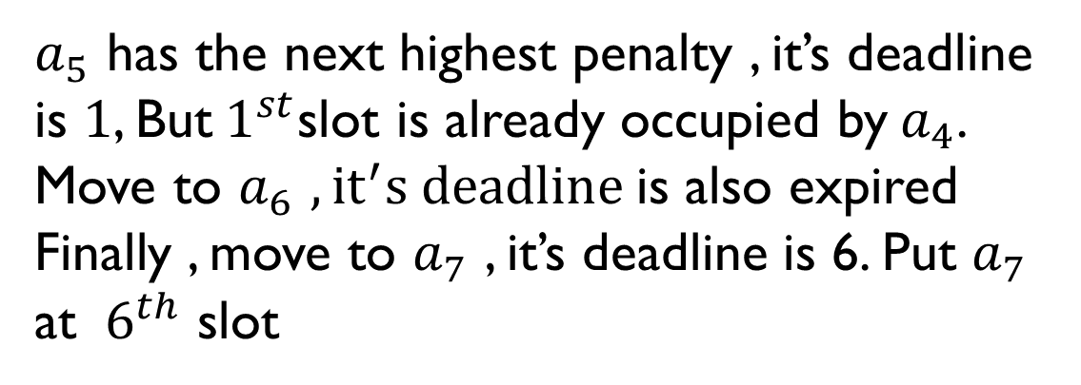
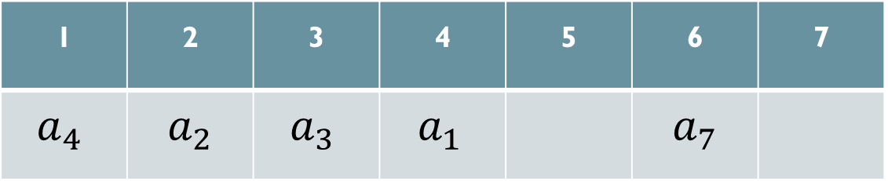
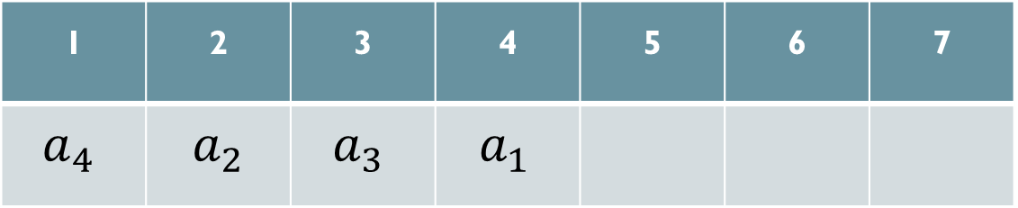
Argue that this algorithm always gives an optimal answer
$a_{5}$ has the next highest penalty , it’s deadline is $1$, But${ 1}^{st}$slot is already occupied by${ a}_{4}$.
Move to $a_{6}$ $,{it}^{′}s deadline$is also expired
Finally , move to $a_{7}$ , it’s deadline is 6. Put $a_{7}$
at ${ 6}^{th}$ slot
1 | 2 | 3 | 4 | 5 | 6 | 7
$$a_{4^{ }}$$ | $$a_{2}$$ | $$a_{3^{ }}$$ | $$a_{1^{ }}$$ |  | $$a_{7}$$
1 | 2 | 3 | 4 | 5 | 6 | 7
$$a_{4^{ }}$$ | $$a_{2}$$ | $$a_{3^{ }}$$ | $$a_{1^{ }}$$

Slide 7
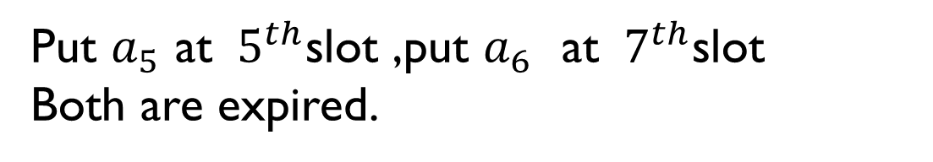
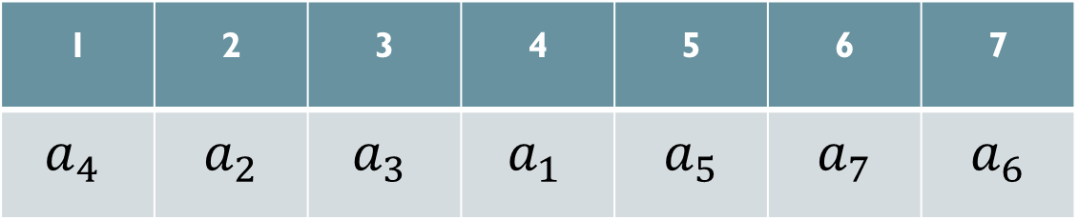
Argue that this algorithm always gives an optimal answer
Put $a_{5}$ at ${ 5}^{th}$slot ,put $a_{6}$ at ${ 7}^{th}$slot
Both are expired.
1 | 2 | 3 | 4 | 5 | 6 | 7
$$a_{4^{ }}$$ | $$a_{2}$$ | $$a_{3^{ }}$$ | $$a_{1^{ }}$$ |  | $$a_{7}$$
1 | 2 | 3 | 4 | 5 | 6 | 7
$$a_{4^{ }}$$ | $$a_{2}$$ | $$a_{3^{ }}$$ | $$a_{1^{ }}$$ | $$a_{5}$$ | $$a_{7}$$ | $$a_{6}$$

Slide 8
Argue that this algorithm always gives an optimal answer
The minimum penalty of this optimal solution: p5 + p6 = 15 + 10 = 25
1 | 2 | 3 | 4 | 5 | 6 | 7
$$a_{4^{ }}$$ | $$a_{2}$$ | $$a_{3^{ }}$$ | $$a_{1^{ }}$$ | $$a_{5}$$ | $$a_{7}$$ | $$a_{6}$$

Slide 9
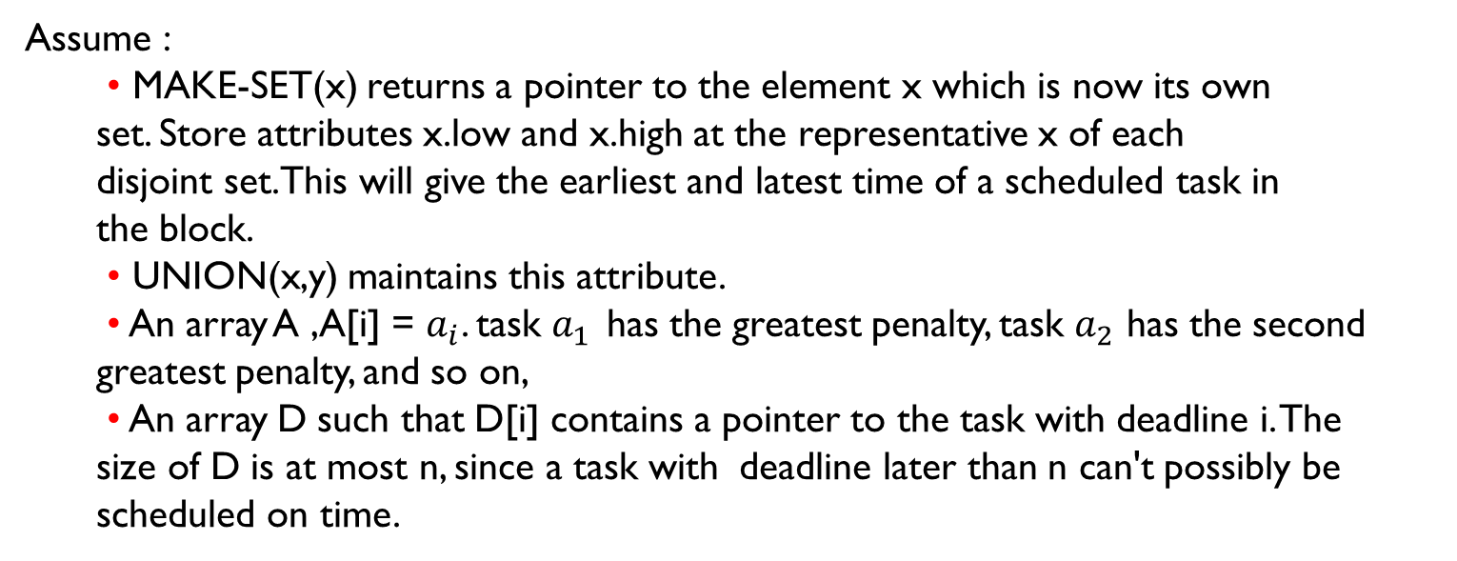
Pseudo code
Assume :
• MAKE-SET(x) returns a pointer to the element x which is now its own set. Store attributes x.low and x.high at the representative x of each disjoint set.This will give the earliest and latest time of a scheduled task in the block.
• UNION(x,y) maintains this attribute.
• An array A ,A[i] = $a_{i}$. task $a_{1^{ }}$ has the greatest penalty, task $a_{2}$ has the second greatest penalty, and so on,
• An array D such that D[i] contains a pointer to the task with deadline i. The size of D is at most n, since a task with deadline later than n can't possibly be scheduled on time.

Slide 10
SCHEDULING-VARIATAIONS(A)
let D[1….n] is a new array
For i =1 to n
a[i].time= a[i].deadline
if D[a[i].deadline]!=NIL
y=FIND-SET(D[a[i].deadline])
a[i].time = y.low - 1
x = MAKE-SET(a[i])
D[a[i].time] = x
x.low = x.high = a[i].time
if D[a[i].time - 1] != NIL
UNION(D[a[i].time - 1], D[a[i].time])
if D[a[i].time + 1] != NIL
UNION(D[a[i].time], D[a[i].time + 1])
RUNTIME:O(nα(n))

